Slide 1

“FINITE STATE MANY PLAYERGAMES: THE
MASTER EQUATION AND FLUCTUATIONS”
Asaf Cohen
(joint with Erhan Bayraktar)
Department of Mathematics
University of Michigan
USC, Math Finance Colloquium
October 2020
1/21

Slide 2

Contents
The n-Player Game and the Master Equation
Fundamental Approximation
Fluctuations
Conclusion and Future Outlook
2/21

Slide 3

Contents
The n-Player Game and the Master Equation
Fundamental Approximation
Fluctuations
Conclusion and Future Outlook
2/21

Slide 4

The n-Player Game and the Master Equation
Literature
Mean-field games:
(1) J.-M. Lasry and P.-L. Lions.Jeux à champ moyen. I. Le cas stationnaire. C. R. Math. Acad. Sci.
Paris, 2006.
(2) J.-M. Lasry and P.-L. Lions.Jeux à champ moyen. II. Horizon ni et contrôle optimal. C. R.
Math. Acad. Sci. Paris, 2006.
(3) J.-M. Lasry and P.-L. Lions. Mean field games. Jpn. J. Math., 2007.
(4) M. Huang, P. E. Caines, and R. P. Malhame. The Nash certainty equivalence principle and Mckean
-Vlasov systems: An invariance principle and entry adaptation. Decision and Control, IEEE, 2007.
(5) M. Huang, R. P. Malhame, and P. E. Caines. Large population stochastic dynamic games: Closed
loop McKean-Vlasov systems and the Nash certainty equivalence principle. Commun. Inf. Syst.,
2006.
The literature expanding rapidly. Our underlying model is based on:
(6) D. A. Gomes, J. Mohr, and R. Souza. Continuous time finite state mean field games. AMO, 2013.
The following paper also considers the same model as ours and studies finite-state MFGs:
(7) A. Cechin, G. Pelino. Convergence, Fluctuations and Large Deviations for finite state Mean
Field Games via the Master Equation, SPA, 2019.
3/21

Slide 5

The n-Player Game and the Master Equation
Literature – contd.
The master equation in mean-field games:
This is a PDE equation, whose solution is associated with the limit of the value functions.
(1) D. A. Gomes, R. M. Velho, and M.-T. Wolfram. Socio-economic applications of finite state mean
field games. Phil. Trans. R. Soc. A, 2014.
(2) R. Carmona and F. Delarue.The master equation for large population equilibriums. Stoch.
Analysis & App., 2014.
(3) A. Bensoussan, J. Frehse, and P. Yam. The master equation in mean field theory. J. de Math.
Pures et App., 2015.
(4) Gangbo, W. and Swiech A. Existence of a solution to an equation arising from the theory of
mean field games, J. Diff. Eqs., 2015.
(5) R. Carmona and P. Wang.Finite state mean field games with major and minor players. arXiv,
2016.
(6) P. Cardaliaguet, F. Delarue, J.-M. Lasry, and P.-L. Lions.The master equation and the
convergence problem in mean field games. Princeton Press, 2019
(7) F. Delarue, D. Lacker, and K. Ramanan. From the master equation to mean field game limit
theory: A central limit theorem. EJoP,2019.
(8) JF. Chassanguex, D. Crisan,F. Delarue. A probabilistic approach to classical solutions of the
master equation for large population equilibria. Memoirs of the AMS, to appear.
3/21

Slide 6

The n-Player Game and the Master Equation
Literature – contd.
(9) Cardaliaguet, P., Cirant M. and Porretta, A. Splitting methods and short time existence for the
master equations in mean field games, preprint.
(10) Gangbo, W. and Meszaros, A. Global wellposedness of Master equations for deterministic
displacement convex potential mean field games, preprint.
(11) Wu, C. and Zhang, J. Viscosity Solutions to Parabolic Master Equations and McKean-Vlasov
SDEs with Closed-loop Controls, preprint.
(12) Mou, C. and Zhang, J. Wellposedness of Second Order Master Equations for Mean Field Games
with Non-smooth Data, preprint.
This talk is based on the paper:
(13) E. Bayraktar and A. Cohen. Analysis of a finite state many player game using its master
equation, SICON, 2018.
3/21

Slide 7
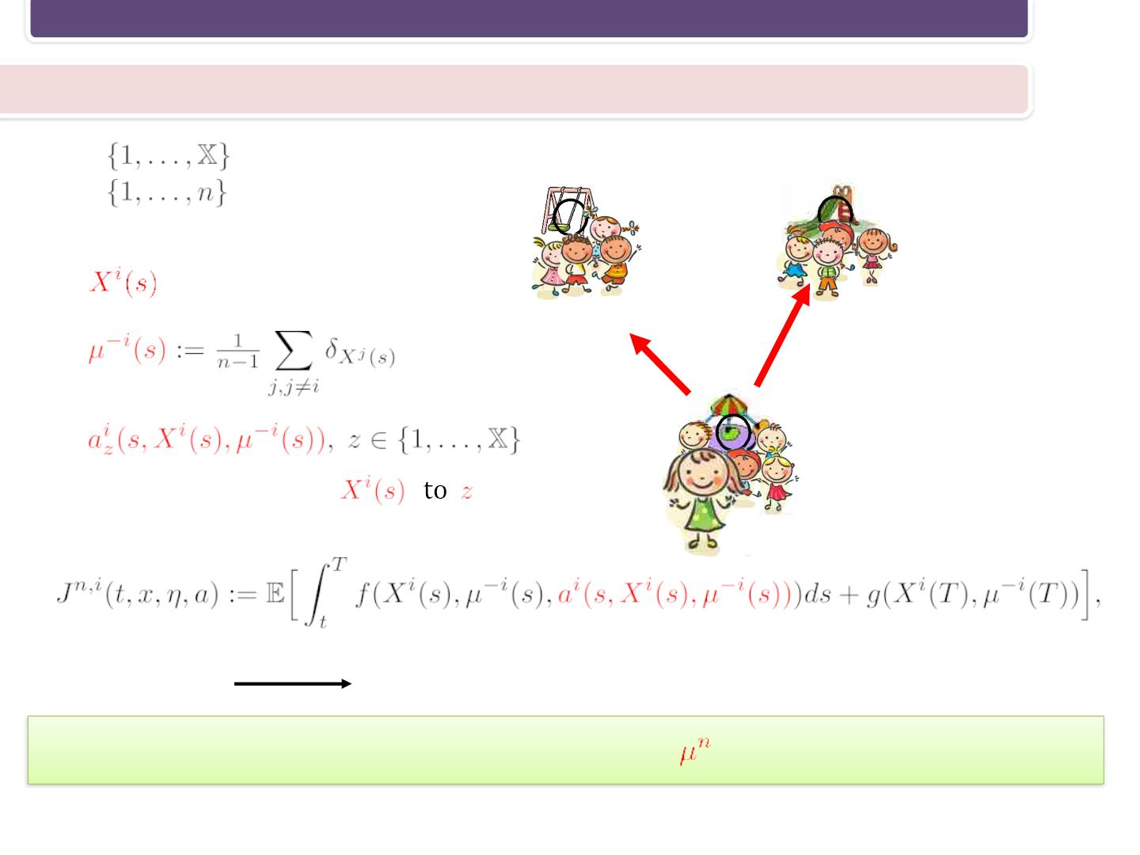
The n-Player Game and the Master Equation
The n-Player Game
•
•
– states
– players
• T – time horizon
2
3
•
•
– private state
•
1
rate of moving from
.
Private cost:
MIN
Goal: find the fluctuations for the empirical measure
under equilibrium
4/21

Slide 8
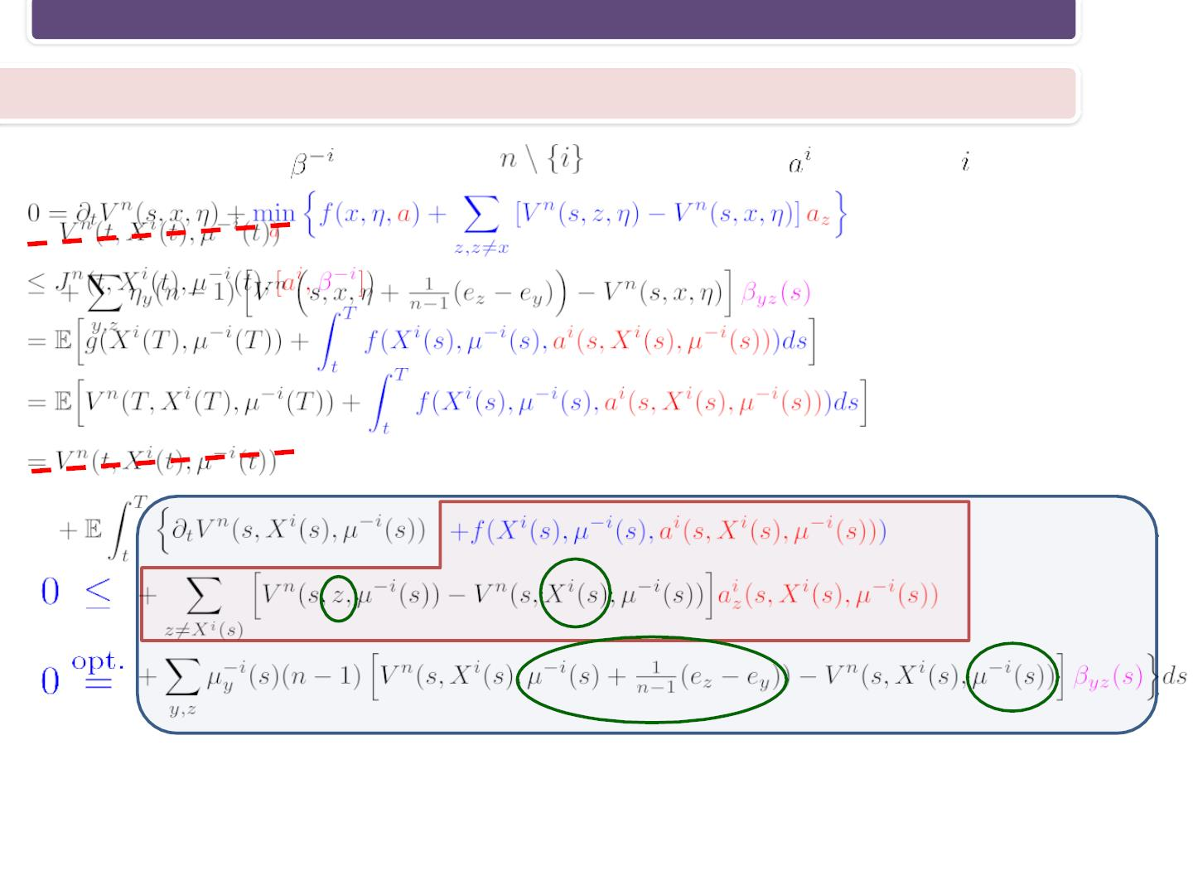
The n-Player Game and the Master Equation
The Hamilton–Jacobi–Bellman equation
Fix a strategy profile
for players
and a strategy
for player
5/21

Slide 9
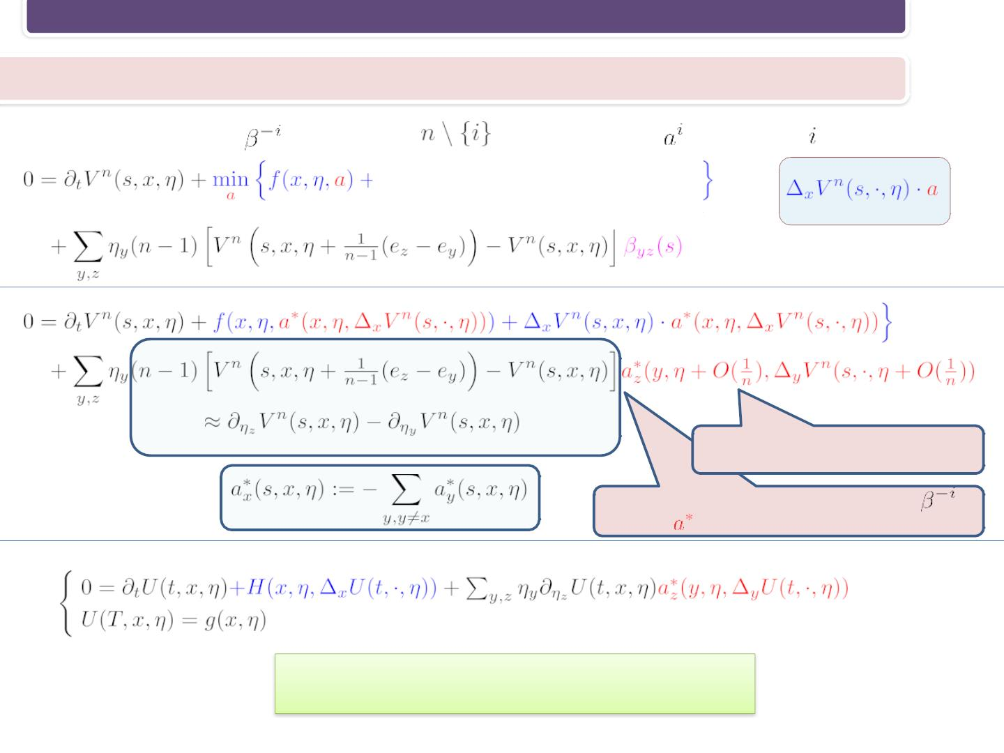
The n-Player Game and the Master Equation
The Hamilton–Jacobi–Bellman equation
Fix a strategy profile
for players
and a strategy
for player
(HJB)
another player’s point of view
symmetric equilibrium, take to be
(ME)
What can we do with the Master Equation?
5/21

Slide 10
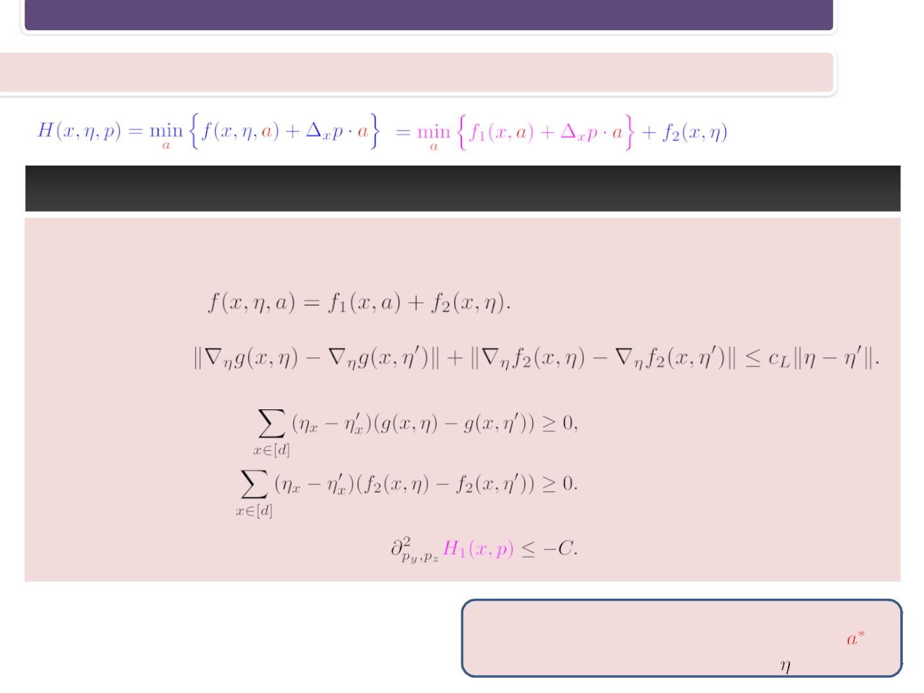
The n-Player Game and the Master Equation
Assumptions
a) [Control set] A compact set bounded away from 0.
b) [Separation]
c) [Lipschitz]
d) [Monotonicity]
e) [Concavity] on compact subsets
the assumptions in most parts of the paper are
less restrictive and directly depends on ew
6/21

Slide 11
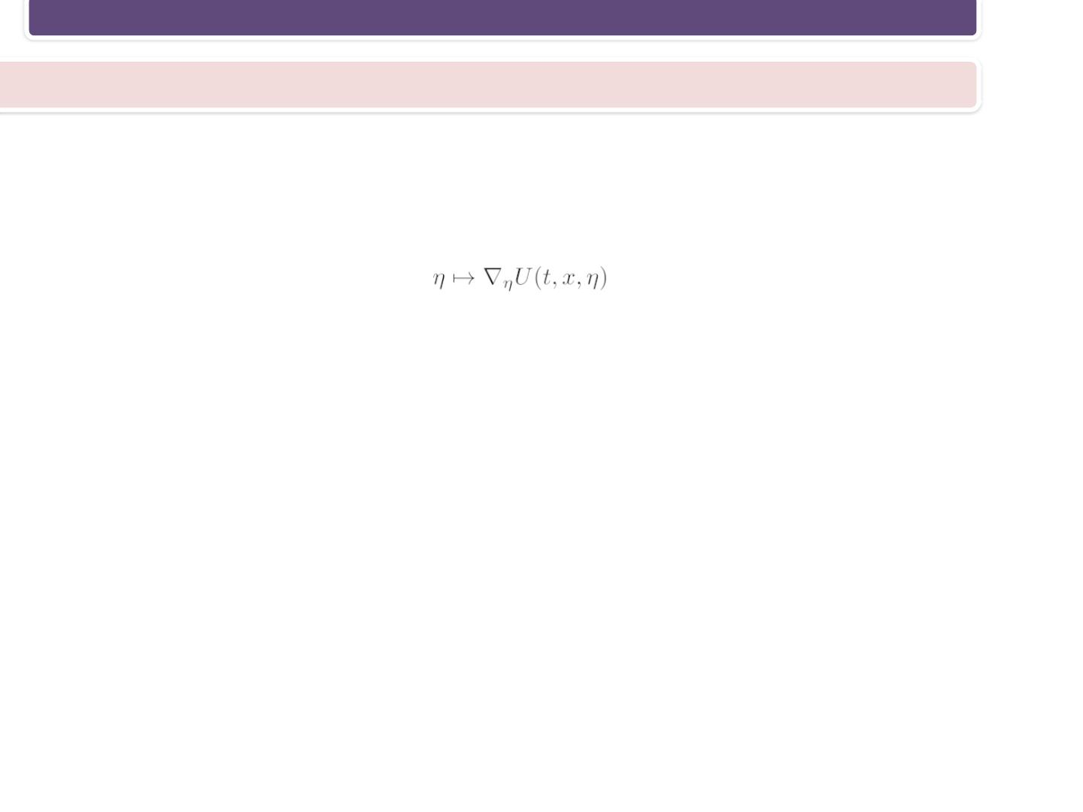
The n-Player Game and the Master Equation
Regularity of the solution of the Master Equation
The Assumptions imply regularity of the control.
Moreover, using PDEtechniques (linearizing a coupled forward-backward system, a
fixed point theorem) we show that
essential for the forthcoming results.
is Lipschitz. This property is
Forward PDE: measure
Backward PDE: value function
7/21

Slide 12

Contents
The n-Player Game and the Master Equation
Fundamental Approximation
Fluctuations
Conclusion and Future Outlook
8/21

Slide 13
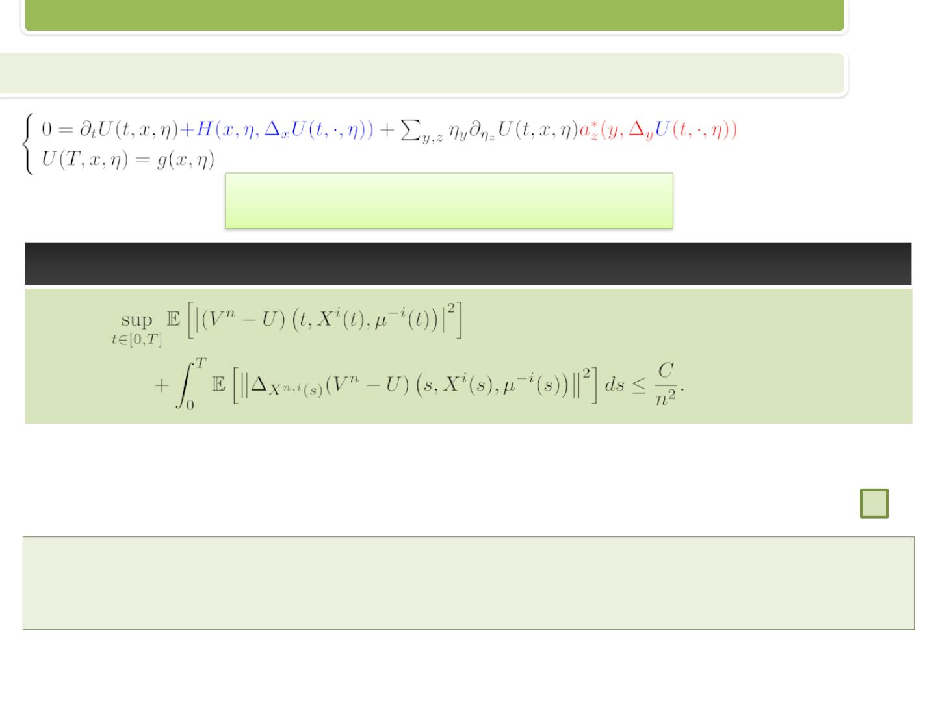
Fundamental Approximation
Approximating the value function
(ME)
What can we do with the Master Equation?
Proof. Ito’̂s lemma, Gronwall’s inequality, the structure of (HJB) and (ME)…
Already we improved the results of
D. A. Gomes, J. Mohr, and R. Souza. Continuous time finite state mean field games. AMO, 2013.
which hold only on small time interval.
9/21

Slide 14
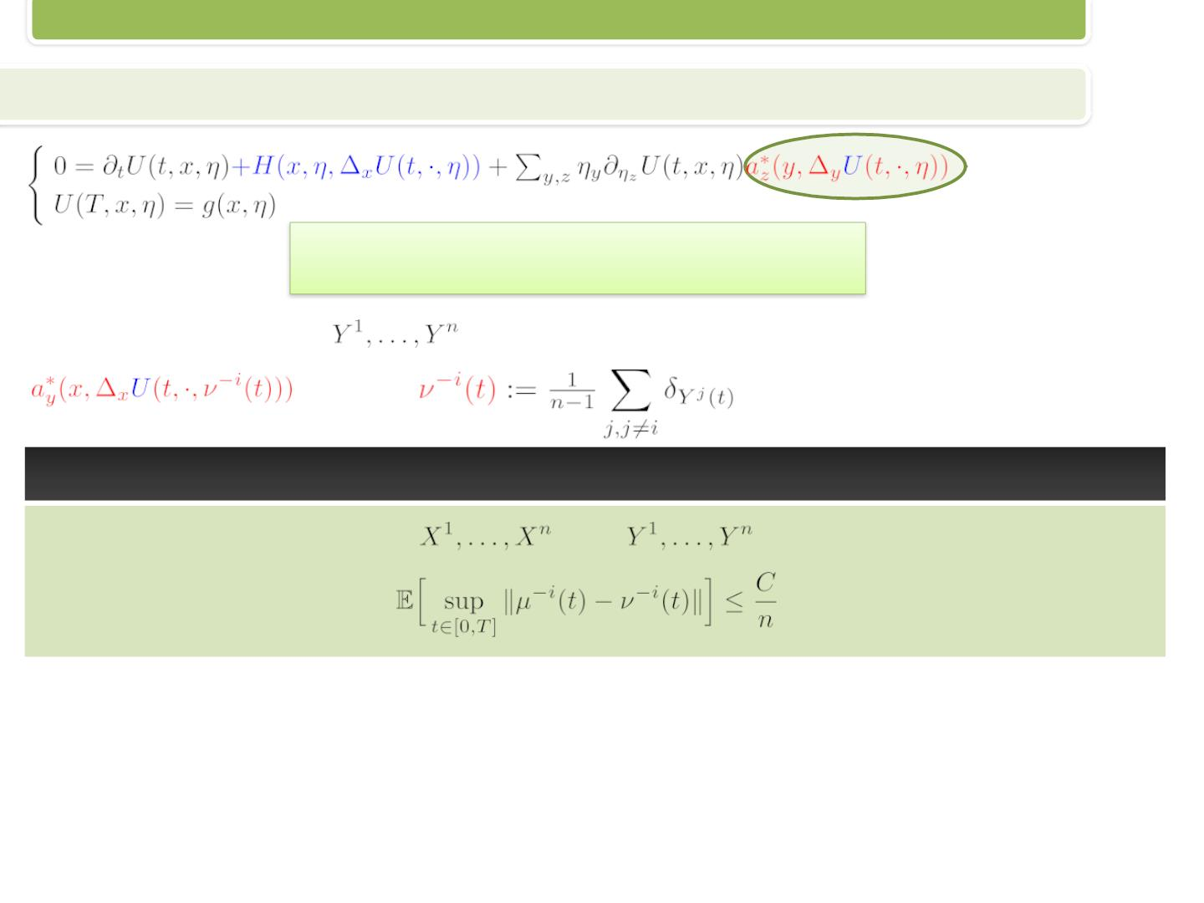
Fundamental Approximation
Approximating the empirical distribution - coupling
(ME)
What can we do with the Master Equation?
Consider the processes
, where
whose transition rates are given by
There is a coupling between
and
such that
10/21

Slide 15
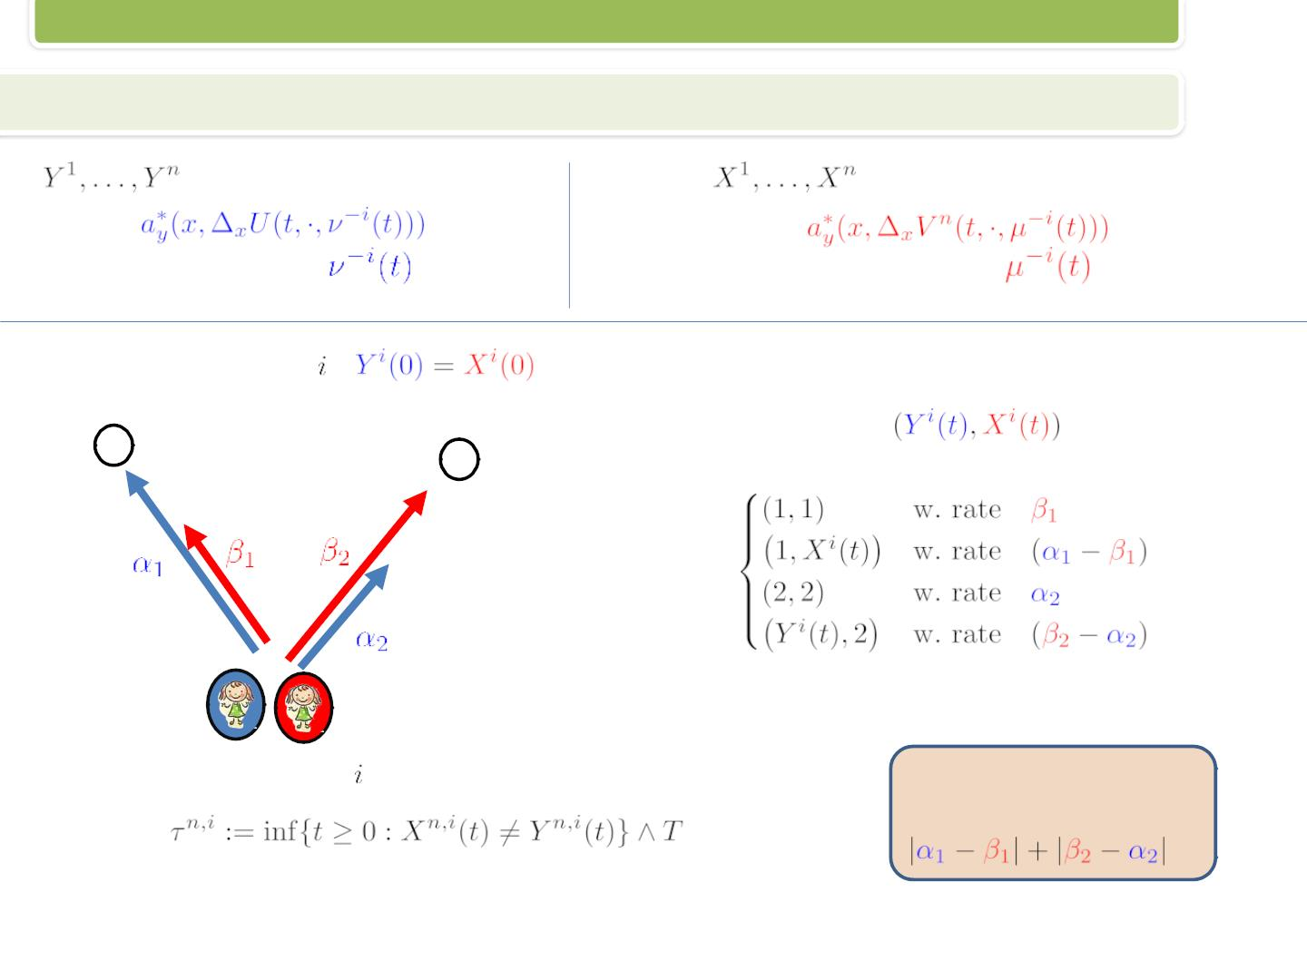
Fundamental Approximation
Approximating the empirical distribution
rates:
empirical measure:
,
rates:
empirical measure:
,
Initially, for every ,
.
The process
jumps to:
1
2
The coupling of pair stops at the first time they split
A key observation:
The splitting rate is
Thereafter, they move independently.
11/21

Slide 16
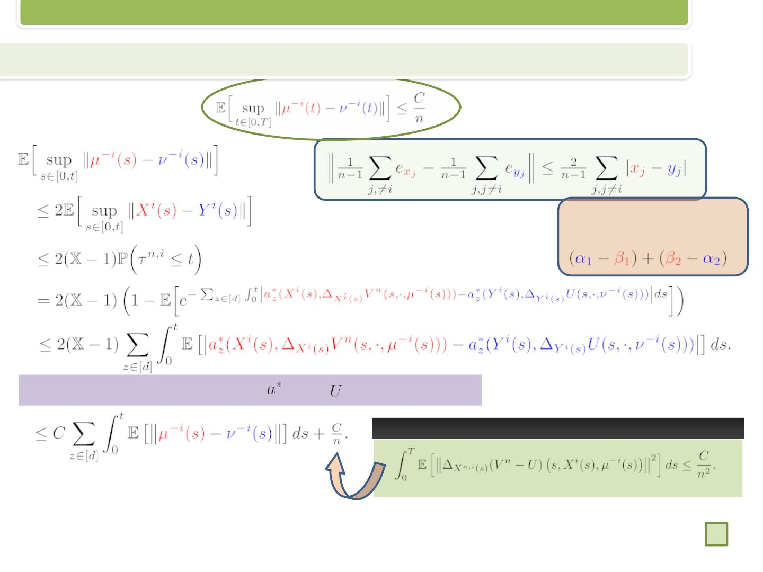
Fundamental Approximation
Approximating the empirical distribution
Proof of Proposition 2:
A key observation:
The splitting rate is
The Assumptions imply that
and
are Lipschitz.
Proposition 1 (Bayraktar and C.)
Gronwall’s inequality….
12/21

Slide 17

Contents
The n-Player Game and the Master Equation
Fundamental Approximation
Fluctuations
Conclusion and Future Outlook
13/21

Slide 18
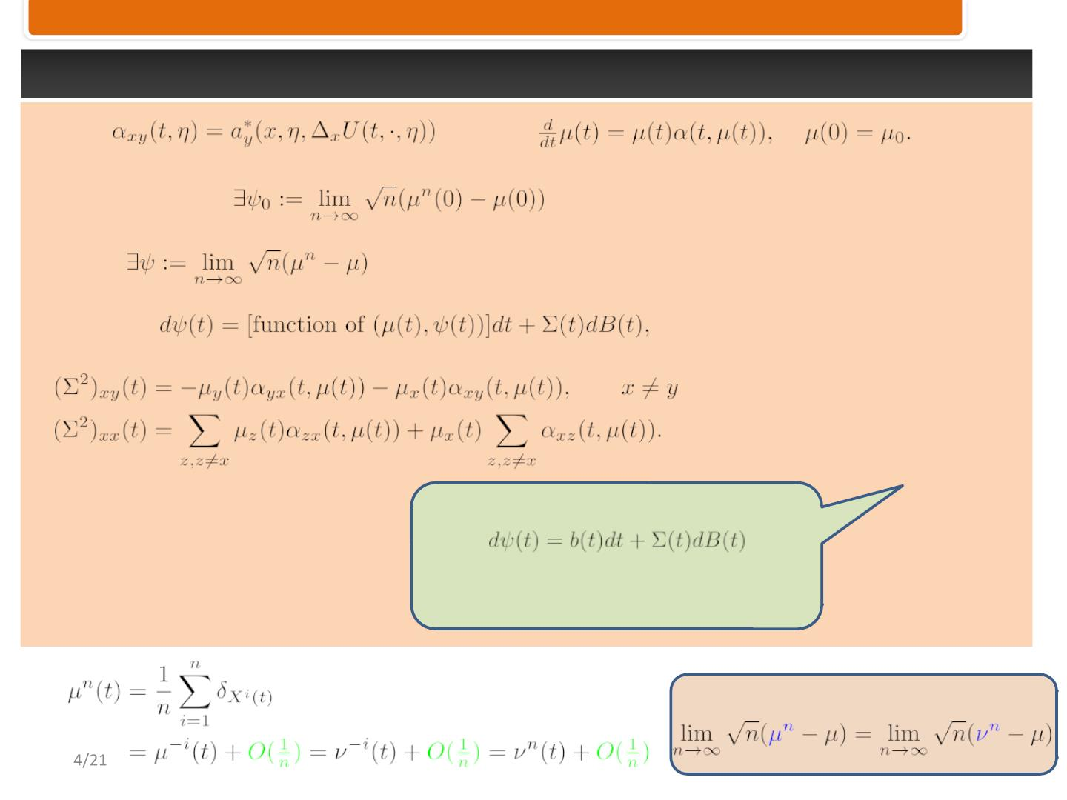
Fluctuations
Set
and
Assuming that
Then
,
where,
Let’s focus on the diffusion structure
rather than on the explicit
expressions
Key idea:
1

Slide 19
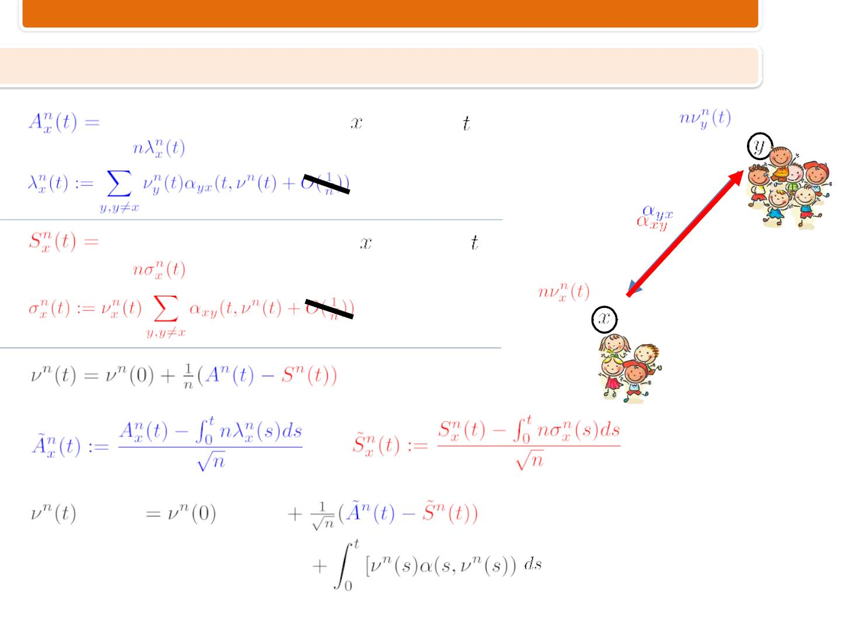
Fluctuations
Proof of Theorem 2 - Notation
# Players moved into state until time .
The rate is , where
# Players moved from state until time .
The rate is , where
15/21

Slide 20
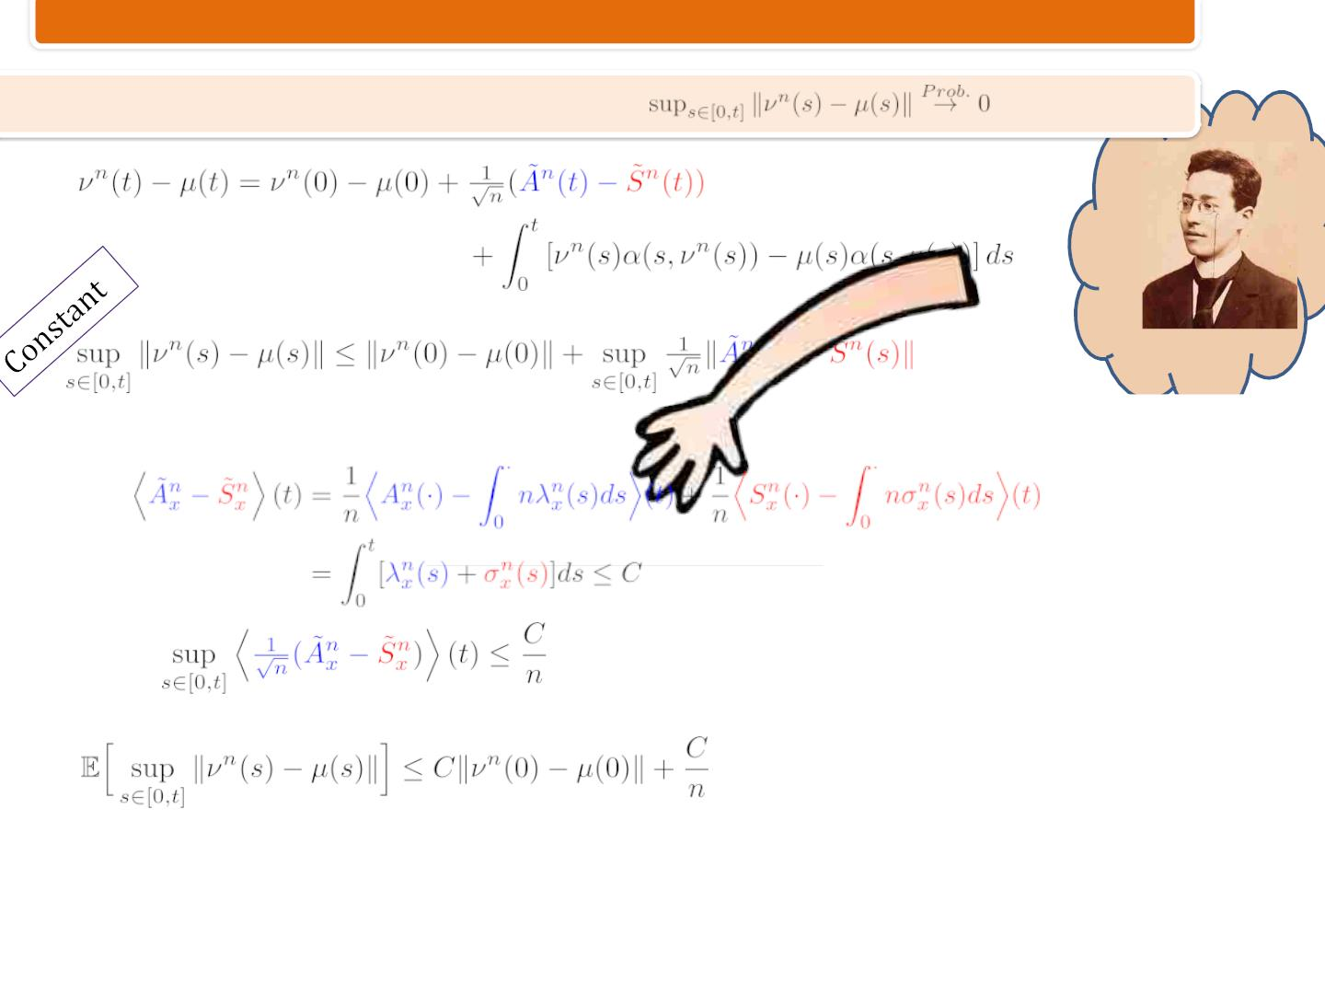
Fluctuations
Proof of Theorem 2 – Fluid Limit
Gronwall
So,
and BDG imply
Markov inequality….
16/21

Slide 21
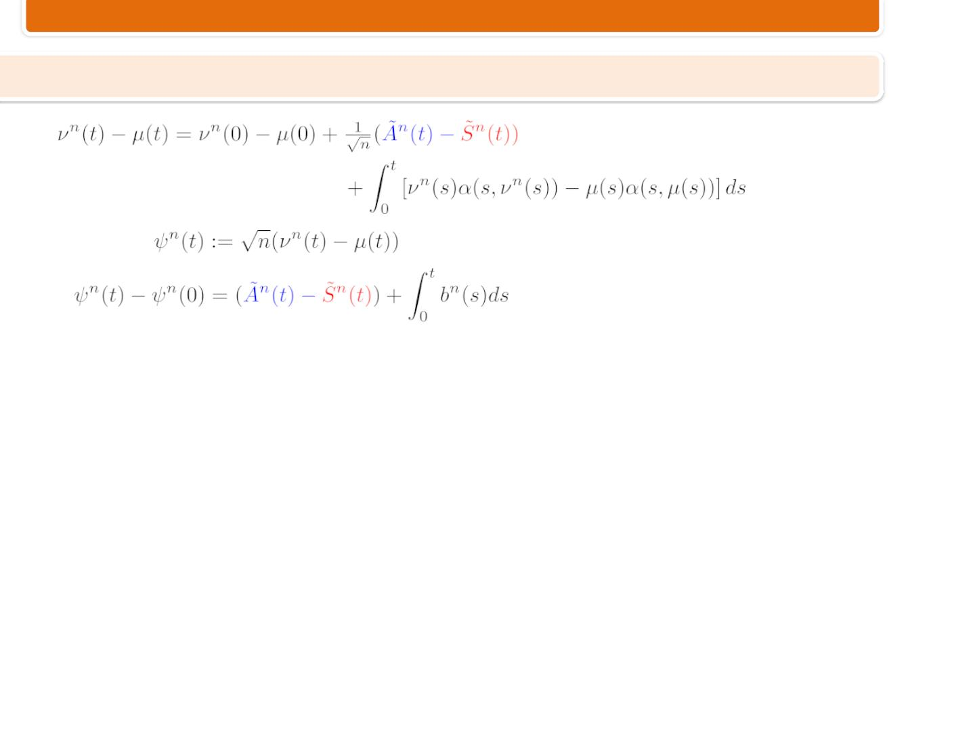
Fluctuations
Proof of Theorem 2 – Diffusion Limit
Setting
, and rearranging the above,
17/21

Slide 22
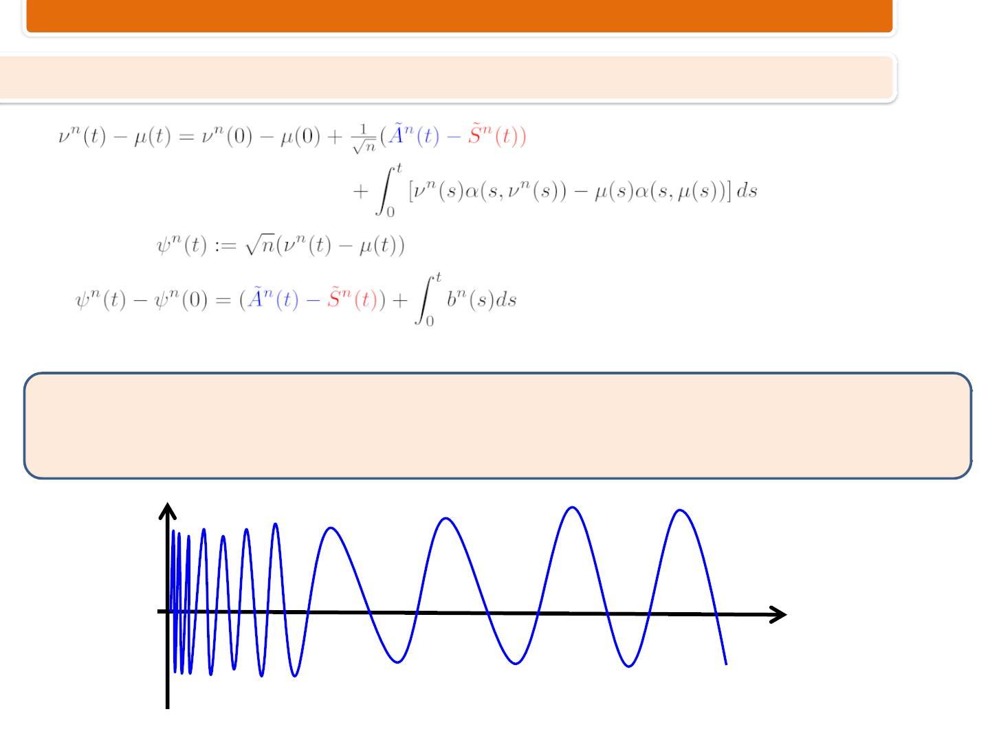
Fluctuations
Proof of Theorem 2 – Diffusion Limit
Setting
, and rearranging the above,
Recall Arzelà–Ascoli theorem:
To attain relatively compactness of functions, they need to be “tamed” . e.g., bounded with the
same Lipschitz const.
17/21

Slide 23
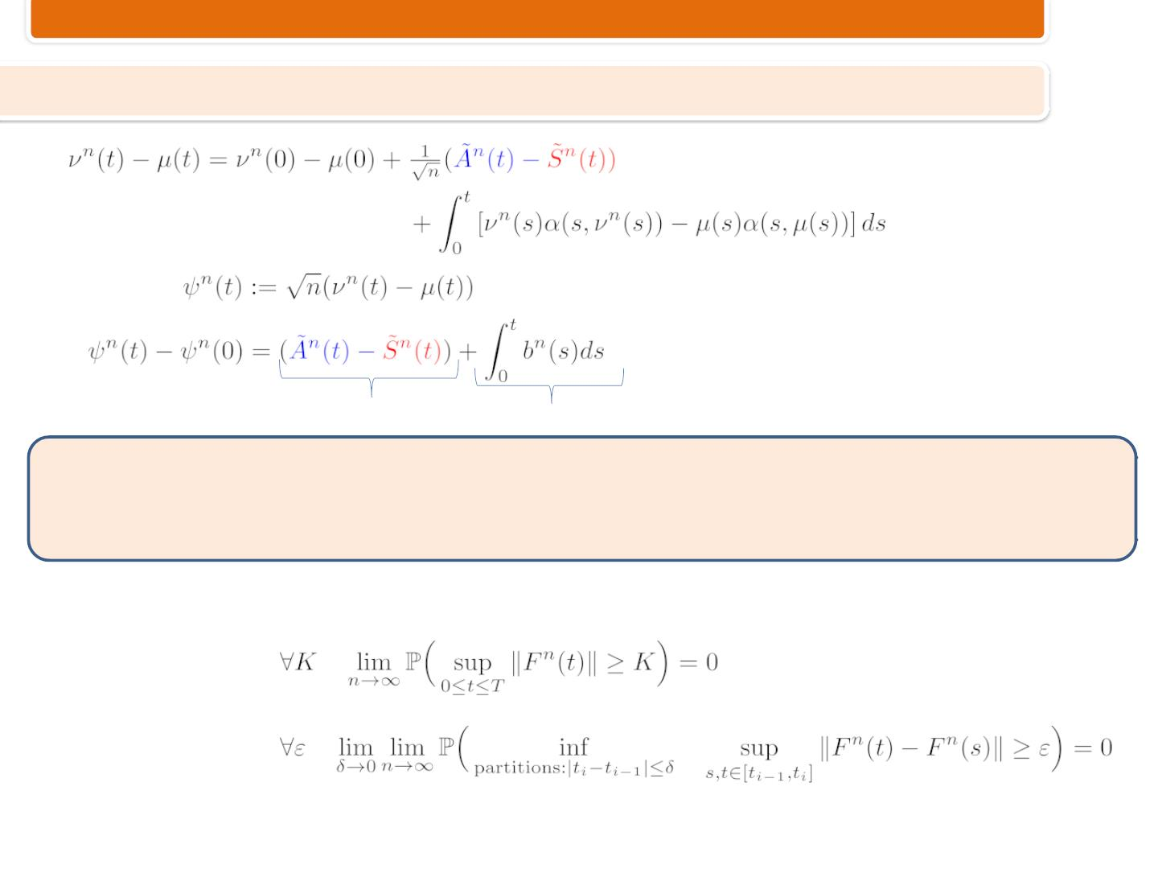
Fluctuations
Proof of Theorem 2 – Diffusion Limit
Setting
, and rearranging the above,
C-tight
C-tight
Recall Arzelà–Ascoli theorem:
To attain relatively compactness of functions, they need to be “tamed” . e.g., bounded with the
same Lipschitz const.
With RCLL processes “tamed” is formulated by tightness:
boundedness
oscillation
17/21

Slide 24
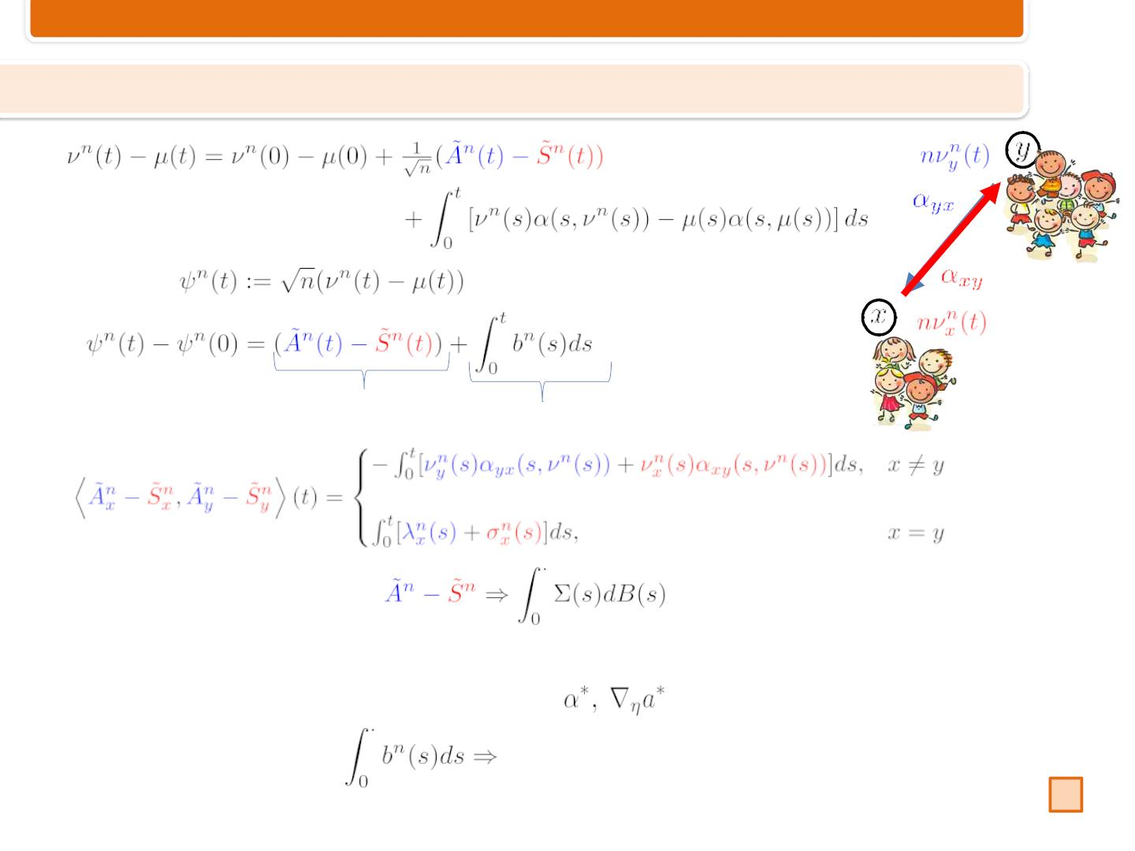
Fluctuations
Proof of Theorem 2 – Diffusion Limit
Setting
, and rearranging the above,
C-tight
C-tight
Martingale CLTimplies
Some technicalities: C-tightness arguments, together with the fluid limit,
boundedness and Lipschitz continuity of , Gronwall’s….
required drift
17/21

Slide 25

Contents
The n-Player Game and the Master Equation
Fundamental Approximation
Fluctuations
Conclusion and Future Outlook
18/21

Slide 26

Conclusion
• Characterized the limits of the value function, optimal control, and empirical
distribution.
• Fluctuations result.
• Convergence rates.
• Solved a coupled forward-backward PDE.
• Used probability tools: coupling, weak convergence, tightness, ...
19/21

Slide 27

Future Outlook
(1) Social planner
(2) Common noise
(3) Graph structure
(4) Mechanism design and learning
(5) Real-world applications
20/21

Slide 28
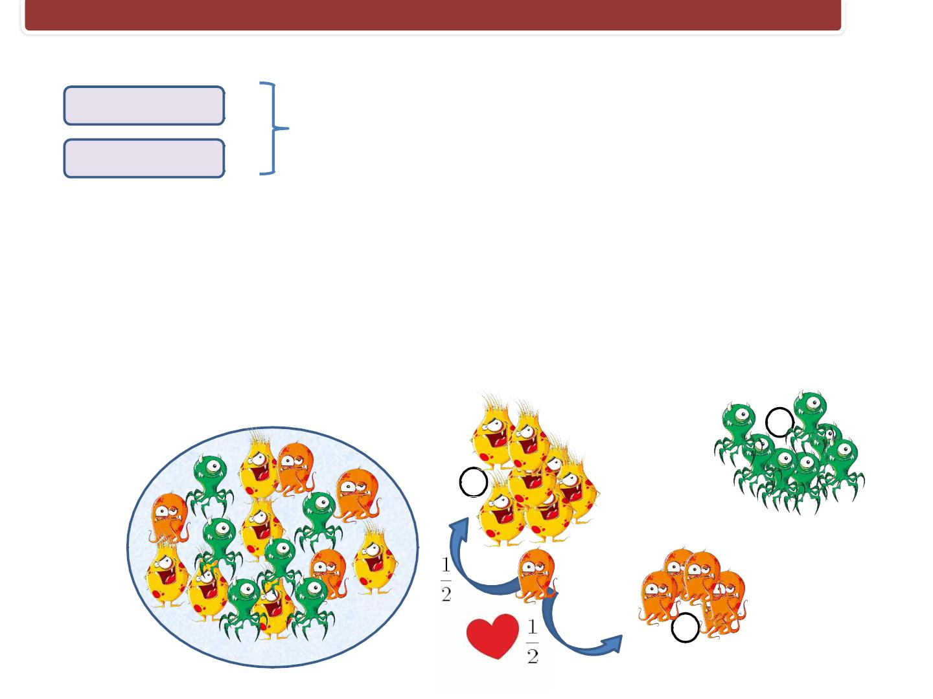
Future Outlook
(1) Social planner
(2) Common noise
(3) Graph structure
Wright-Fisher/Moran control problem
(4) Mechanism design and learning
(5) Real-world applications
z
x
y
20/21

Slide 29

Future Outlook
(1) Social planner
(2) Common noise
(3) Graph structure
(4) Mechanism design and learning
(5) Real-world applications
• E. Bayraktar, A. Cohen, A. Cecchin, F.
Delarue. Finite state Mean Field Games with
Wright-Fisher common noise, arXiv, 2019.
• A. Cecchin and F. Delarue. Selection by
vanishing common noise for potential finite
state mean field games, arXiv, 2020.
20/21

Slide 30
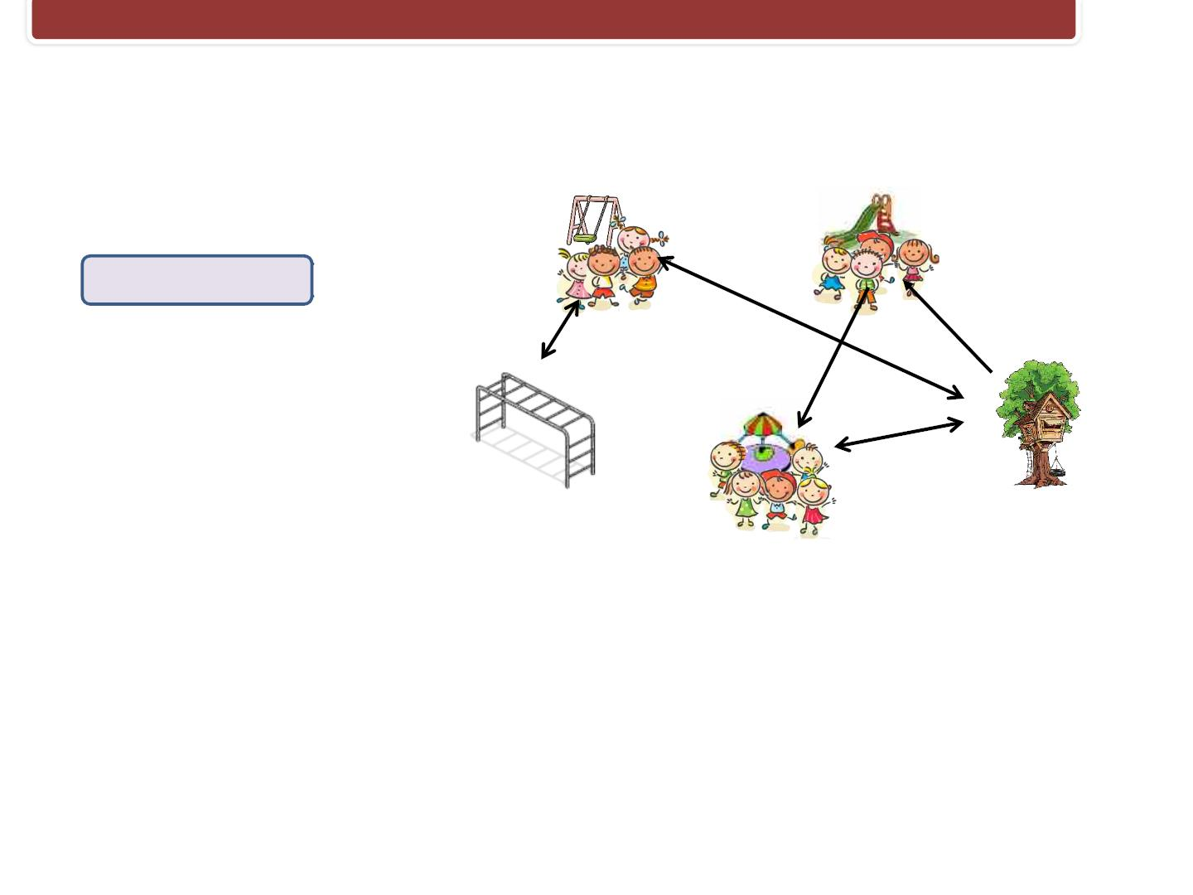
Future Outlook
(1) Social planner
(2) Common noise
(3) Graph structure
(4) Mechanism design and learning
(5) Real-world applications
20/21

Slide 31
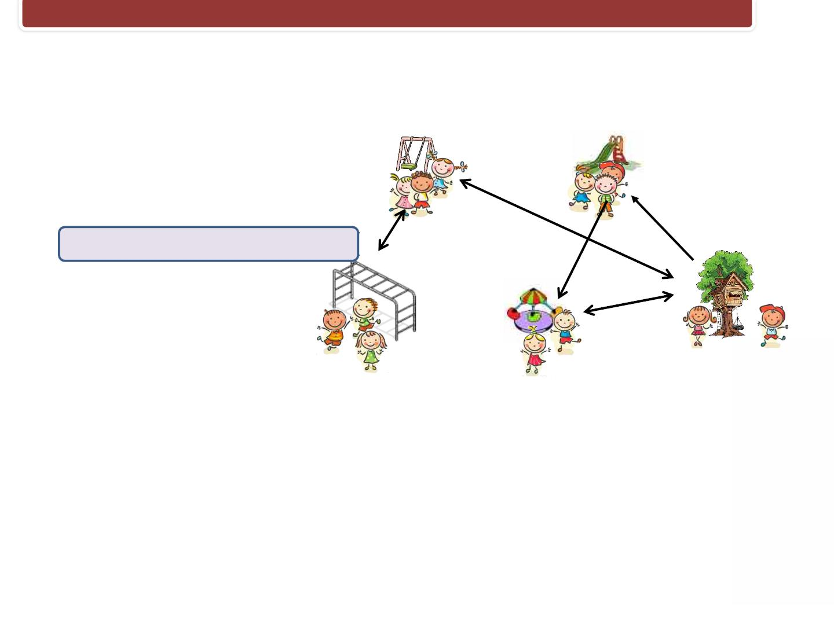
Future Outlook
(1) Social planner
(2) Common noise
(3) Graph structure
(4) Mechanism design and learning
(5) Real-world applications
20/21

Slide 32

Future Outlook
(1) Social planner
(2) Common noise
(3) Graph structure
(4) Mechanism design and learning
(5) Real-world applications
20/21

Slide 33

THANK YOU!
21/21

Slide 34
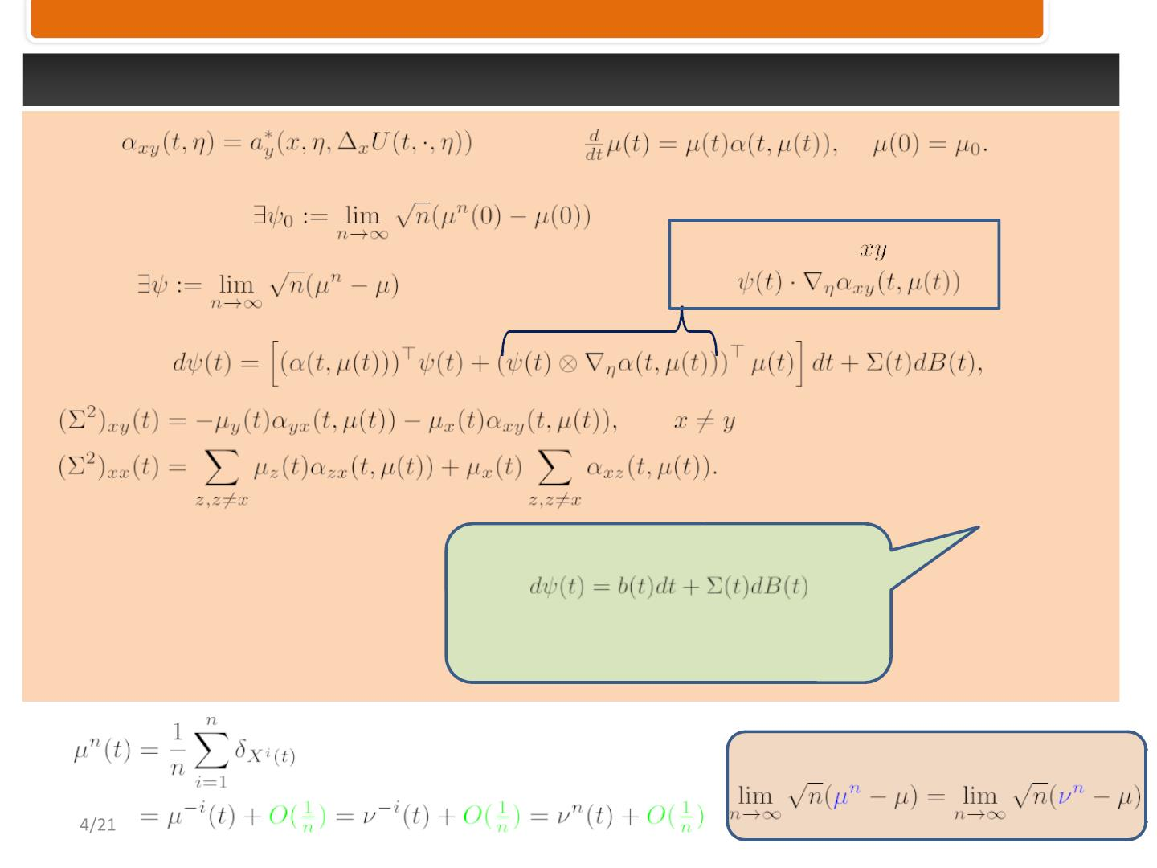
Fluctuations
Set
and
Assuming that
Then
Matrix whose
term is
,
where,
Let’s focus on the diffusion structure
rather than on the explicit
expressions
Key idea:
1

Slide 35
Fluctuations
Set
and
Assuming that
Then
,
where,
Let’s focus on the diffusion structure
rather than on the explicit
expressions
Key idea:
1

Slide 36

Fluctuations
Proof of Theorem 2 – Diffusion Limit
Setting
, and rearranging the above,
C-tight
C-tight
Martingale CLTimplies
Some technicalities: C-tightness arguments, together with the fluid limit,
boundedness and Lipschitz continuity of , Grӧnwall’s….
required drift

Slide 37
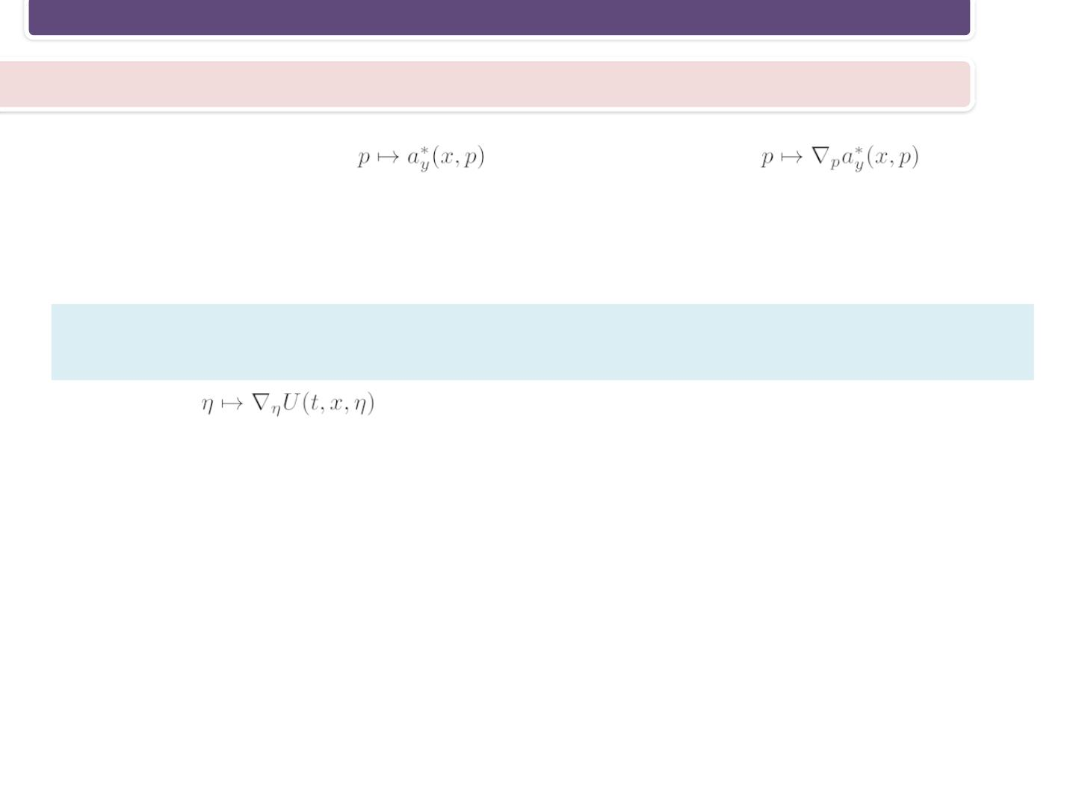
The n-Player Game and the Master Equation
Regularity of the solution of the Master Equation
The Assumptions imply that
Lipschitz continuous.
is regular. Specifically,
is
Following PDE techniques (linearizing a forward-backward system, fixed point
theorems) developed for the diffusion case by
P. Cardaliaguet, F. Delarue, J.-M., and Lasry, P.-L. Lions. The master equation and the
convergence problem in mean field games. arXiv, 2015
we show that
results.
is Lipschitz. This property is essential for the forthcoming
7/19

Slide 38
The n-Player Game and the Master Equation
Regularity of the solution of the Master Equation
The Assumptions imply that
Lipschitz continuous.
is regular. Specifically,
is
Following PDE techniques (linearizing a forward-backward system, fixed point
theorems) developed for the diffusion case by
P. Cardaliaguet, F. Delarue, J.-M., and Lasry, P.-L. Lions. The master equation and the
convergence problem in mean field games. arXiv, 2015
we show that
results.
is Lipschitz. This property is essential for the forthcoming
7/19

Slide 39

The n-Player Game and the Master Equation
Literature – contd.
The master equation in mean-field games:
This is a PDE equation, whose solution is associated with the limit of the value functions.
(1) D. A. Gomes, R. M. Velho, and M.-T. Wolfram. Socio-economic applications of finite state mean
field games. Phil. Trans. R. Soc. A, 2014.
(2) R. Carmona and F. Delarue.The master equation for large population equilibriums. Stoch.
Analysis & App., 2014.
(3) A. Bensoussan, J. Frehse, and P. Yam. The master equation in mean field theory. J. de Math.
Pures et App., 2015.
(4) R. Carmona and P. Wang.Finite state mean field games with major and minor players. arXiv,
2016.
(5) P. Cardaliaguet, F. Delarue, J.-M. Lasry, and P.-L. Lions.The master equation and the
convergence problem in mean field games. arXiv, 2015
(6) F. Delarue, D. Lacker, and K. Ramanan. From the master equation to mean field game limit
theory: A central limit theorem. arXiv, 2018.
(7) F. Delarue, D. Lacker, and K. Ramanan. From the master equation to mean field game limit
theory: Large deviations and concentration of measure. arXiv, 2018.
4/22

Slide 40

40
15/01/2013

